Slide 1

Cultural Transformation
Microsoft Virtual Internship
Template
Research the cultural transformation journey that Microsoft has been through.
Identify the key elements of Microsoft’s current culture driven by Satya Nadella (CEO).
Answer the following three questions (one per slide):
How has Microsoft’s culture transformed?
What are the key elements of the current culture?
What inspires you about Microsoft’s culture?

Slide 2
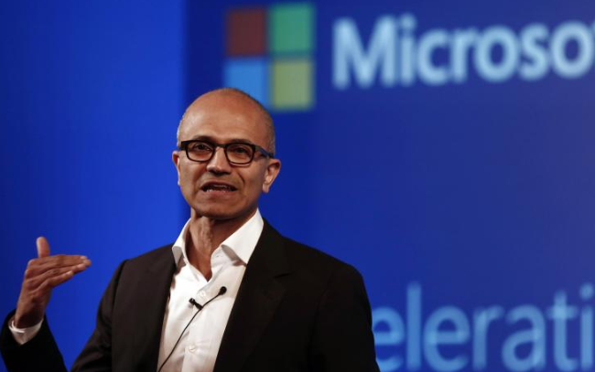
1. How has Microsoft’s culture transformed?
Microsoft Virtual Internship
After Satya became the CEO of Microsoft, he transformed the culture by shifting form “know-it-all” to ”learn-it-all”
He wanted Microsoft to ‘improve’ themselves not to ‘prove’ themselves
A drastic shift from “Fixed Mindset” to “Growth Mindset” was made.

Slide 3

2. What are the key elements of the current culture?
Microsoft Virtual Internship
Have a “Growth Mindset”
Value Learning over Knowing
Being Customer obsessed
Making a difference

Slide 4

3. What inspires you about Microsoft’s culture?
Microsoft Virtual Internship
Just because one person has not found his talent doesn’t mean that he doesn’t have one! One must have a growth mindset always.

